Slide 1
DATA1001 Project 2
BMI & Sleep Quality
Aprial 2021
Tue3RE Group13

Slide 2
1
Data structure
2
Sleep quality issue
CONTENTS
3
Sleep duration vs BMI
4
Weight vs BMI
5
Summary

Slide 3
1
Data Structure
structure & type & main variable

Slide 4
Gender & Occupation
Male participants —30%
Female participants —70%
occupation

Slide 5
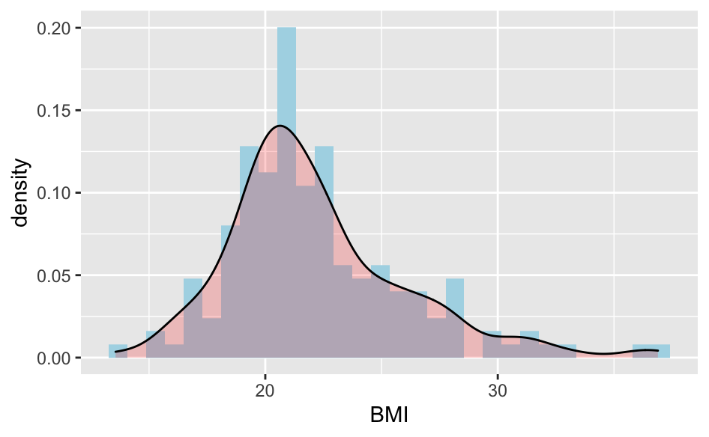
BMI distribution
Minimum | Maximum | Median | Mean
13.56 | 36.89 | 21.26 | 22.18

Slide 6
2
Sleep Quality
duration & time & quality

Slide 7
Sleep duration proportion
42 participants sleep less than 7 hours per day
72 participants sleep more than 7 hours per day
41 participants sleep just 7 hours per day

Slide 8
Sleep quality proportion

Slide 9
Does sleep time affect sleep quality ?

Slide 10
3
Does sleep duration affect BMI ?

Slide 11
Scatter plot of sleep duration and BMI
y = BMI
x = sleep duration

Slide 12
4
Weight vs BMI

Slide 13
Scatter plot of weight and BMI
y = BMI
x = body weight

Slide 14
5
Summary

Slide 15
Main Discoveries
Sleep Quality
Sleep Duration
Weight
32.5% of the participants have poor sleep quality, and the time they went to bed has no significant effect on sleep quality.
The longer you sleep, the lower your body mass index.
There is a strong positive correlation between body weight and BMI.

Slide 16
THANK YOU

